Slide 1

Movies Data Analysis
Recommendations for Microsoft's Film Production Company
By Brenda Kinya

Slide 2

Overview
I analyzed Movie Datasets from 2 sites:
Box Office Mojo
IMDB
My analysis can assist Microsoft in producing top-quality movies by identifying the optimal length, prevalent genres, and favorable release periods

Slide 3

Outline
Problem Statement
Data
Methods
Results
Conclusions

Slide 4
Business Problem Statement
Microsoft lacks expertise in the field of movie production, yet they intend to establish a new movie studio.
For the new movie studio to generate profit, Microsoft should consider the following factors:
The most popular genre
The run time for the movies
The top studios
The ideal period to release the movies based on the Average ROI of film release by month

Slide 5

Data
I analyzed data from the Box Office Mojo and IMDB
The data carried information about movie titles, runtime, movie release dates, studio names and domestic and foreign gross

Slide 6

Methods
I used descriptive statistics and data visualizations to analyze and present the data and describe the movie trends

Slide 7
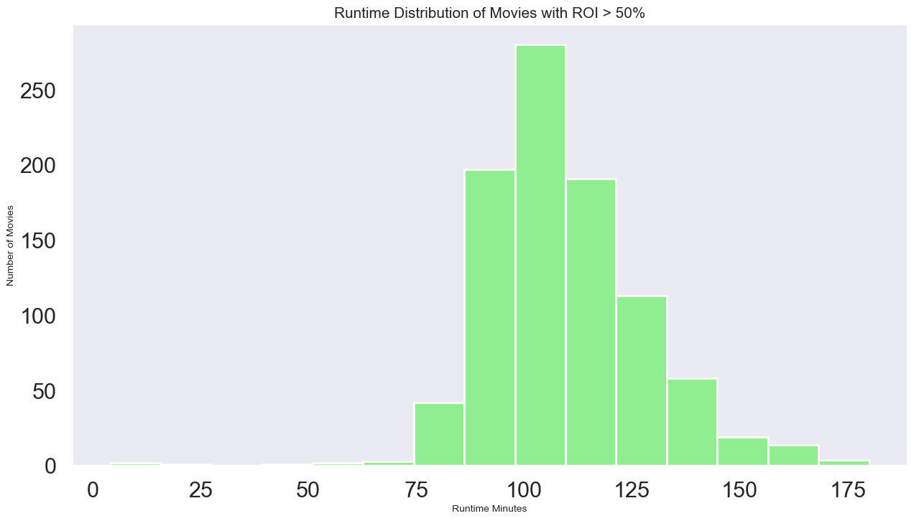
Movie Runtime Distribution
The best run time seems to be approximately between 90 and 120 minutes

Slide 8
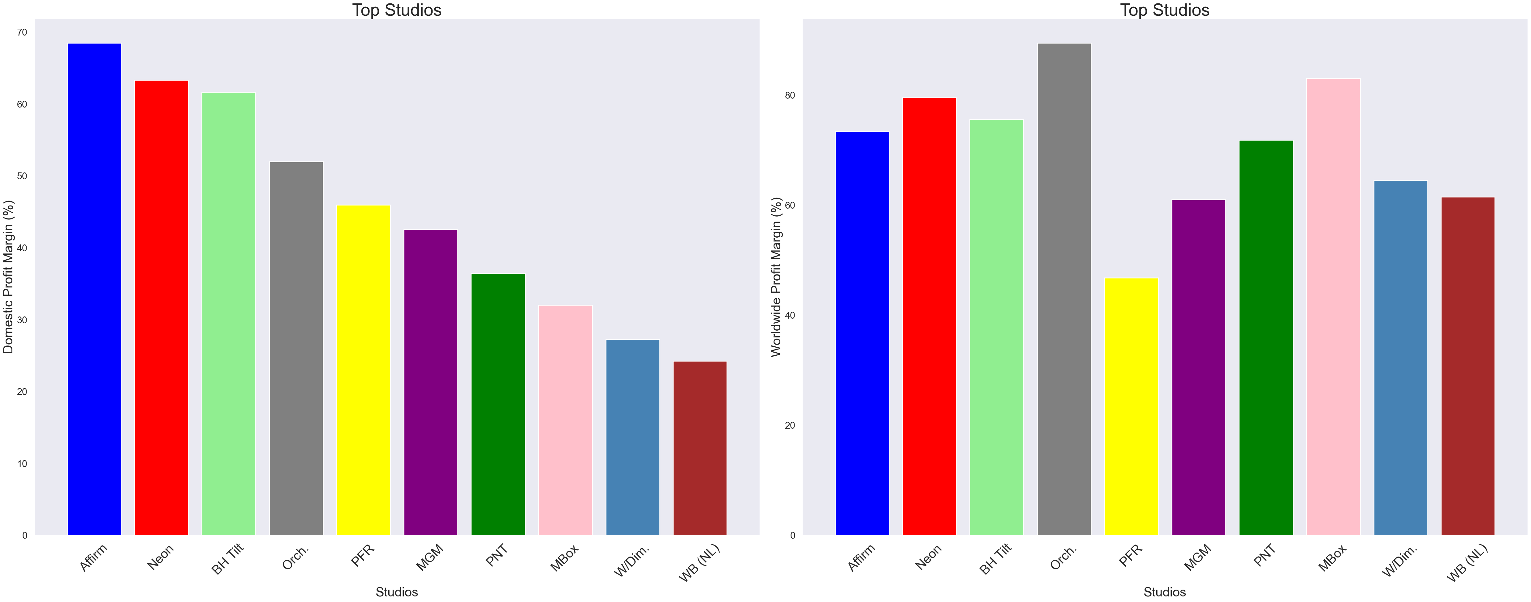
Top Studios
The best movie studios globally
According to the charts, Affirm studio had the highest domestic earnings, but it only ranked fifth in terms of global earnings among all studios. This suggests that there is a disparity between the top earning studios domestically versus globally. Just because a movie studio performs well domestically, it does not necessarily mean that it will be a top earner on a global scale.

Slide 9
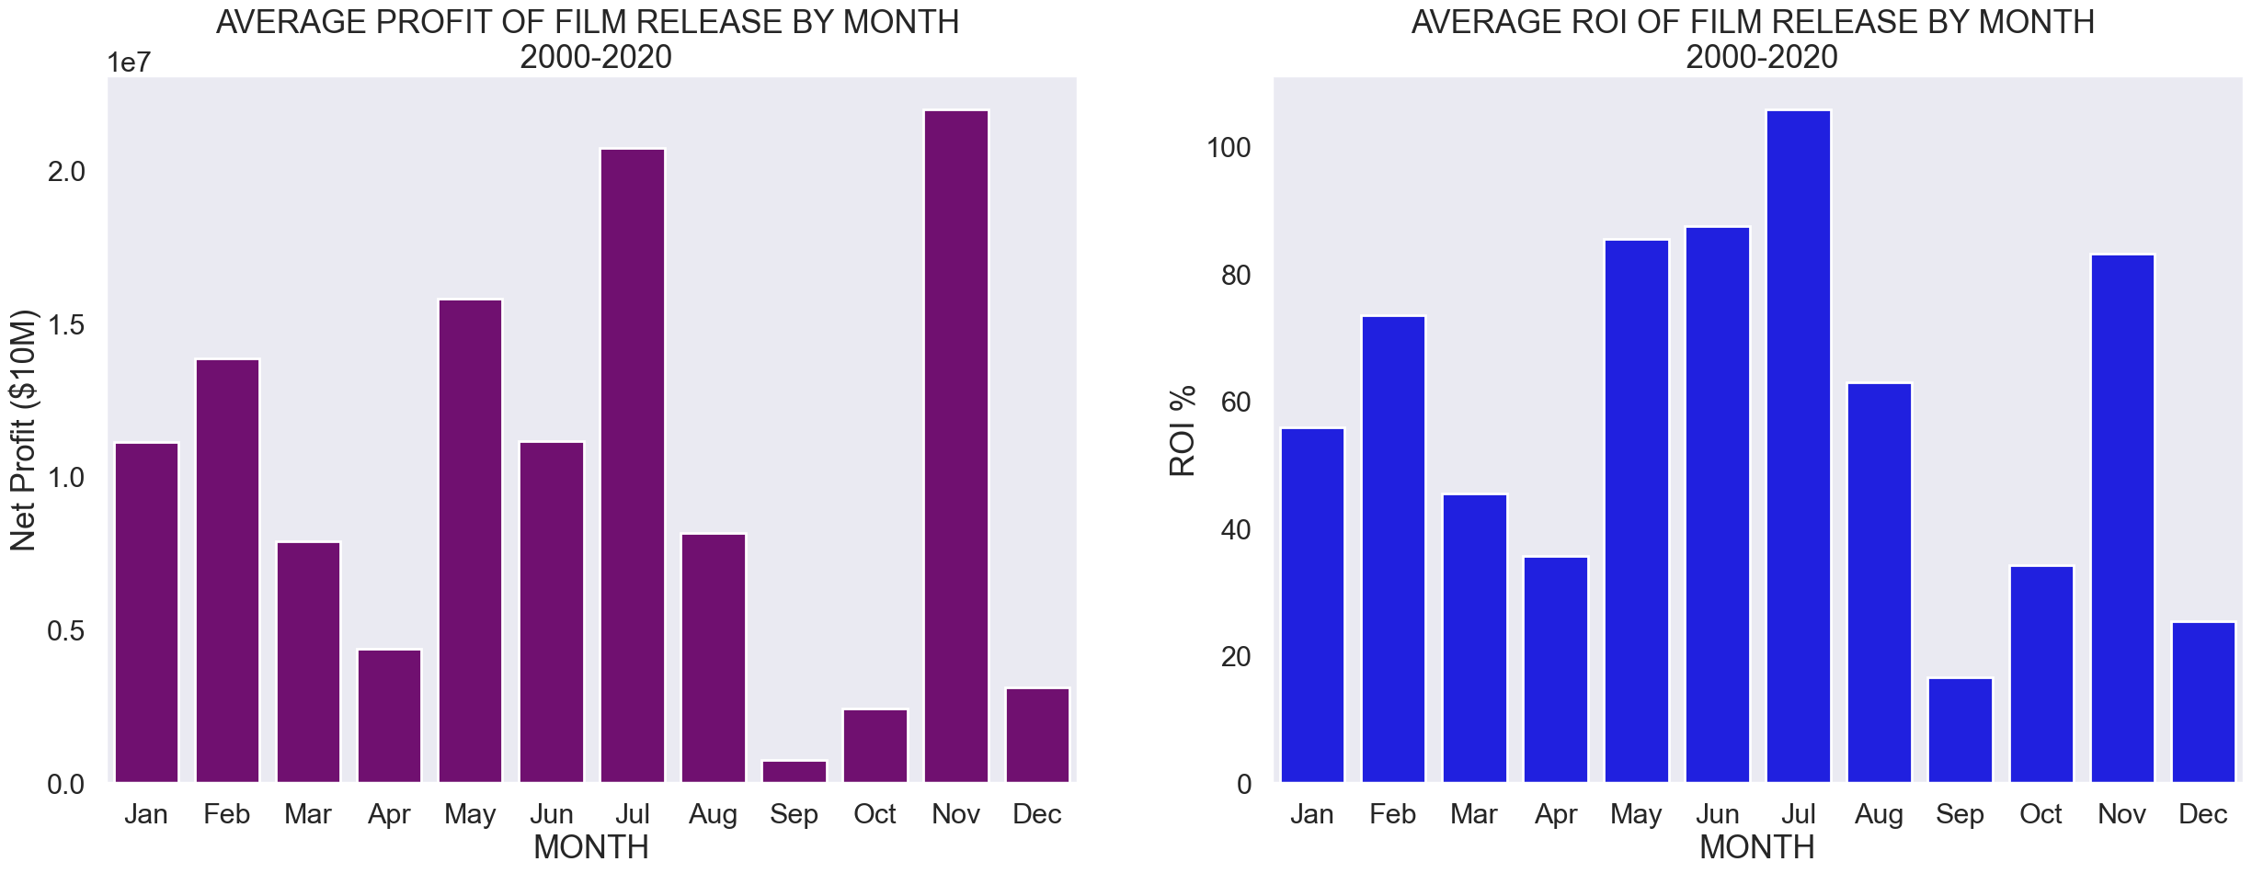
Movie Release Months
The most favourable months to release movies based on average ROI
The films that were released during the months of July, June, November and May yielded the greatest Return on Investment (ROI) respectively compared to those released during other months. On the other hand, movies that premiered in September, December, October and April had the lowest ROIs.

Slide 10
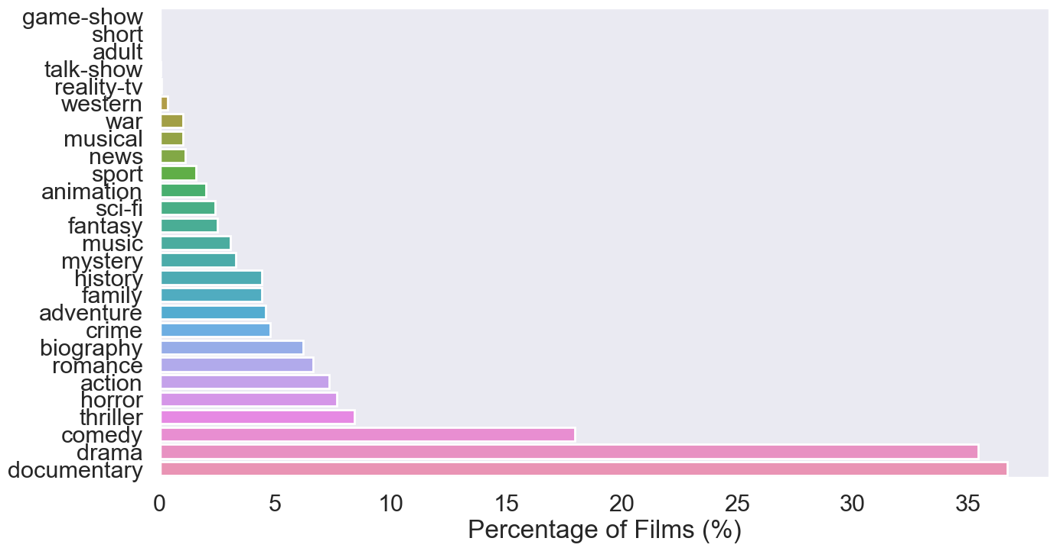
Genre
The most popular genres
The figure depicts how unique genres are distributed in the dataset. Documentary was found to be the most prevalent genre, accounting for over 35% of the films, followed by drama and comedy.

Slide 11
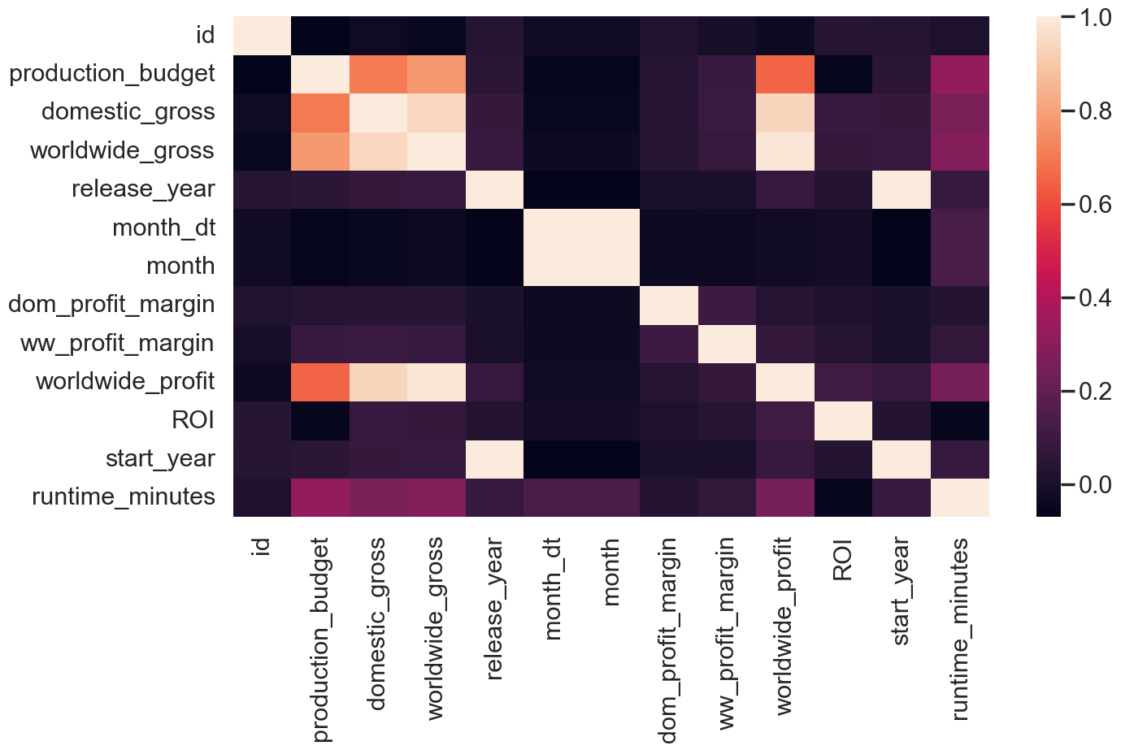
Heatmap
Depicts Correlation
The heatmap suggests a weak or nonexistent correlation between production budget and ROI. Thus, it can be inferred that a high production budget does not necessarily result in higher returns for a movie. However, the situation is different for domestic and worldwide gross, as the calculation methods for movie gross and ROI differ

Slide 12
Conclusions
Based on the movie analysis, the following conclusions can be drawn:
It is advisable to produce movies with a runtime of 90 to 120 minutes.
To optimize earnings, movie release dates should be limited to May, June, July, and November.
Microsoft may consider acquiring one of the top grossing studios, such as BH Tilt, Neon, or Orchard Film Studios.
It would be beneficial for Microsoft to produce movies in the most prevalent genres, namely documentaries, drama, and comedy.

